Slide 1
Infectious Diseases
Caused by
Airborne and Contact Viruses
CDC Guidelines
Specific Agents/Diseases

Slide 2
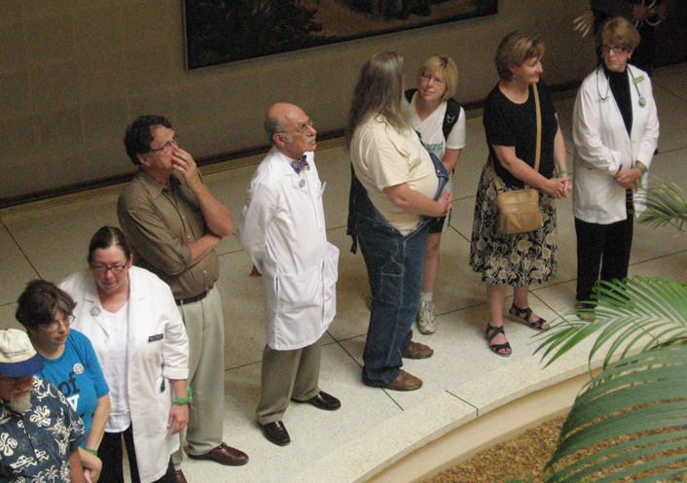
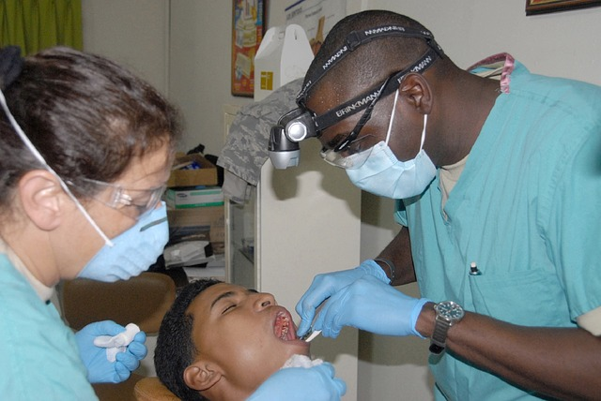
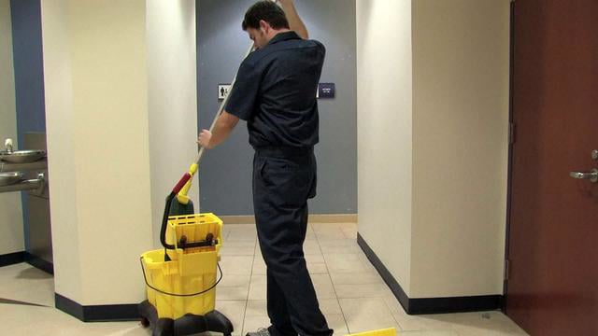
Healthcare workers (HCWs) are occupationally exposed to a variety of infectious diseases during the performance of their duties. The delivery of healthcare services requires a broad range of workers, such as physicians, nurses, technicians, clinical laboratory workers, first responders, building maintenance, security and administrative personnel, social workers, and housekeeping personnel.

Slide 3
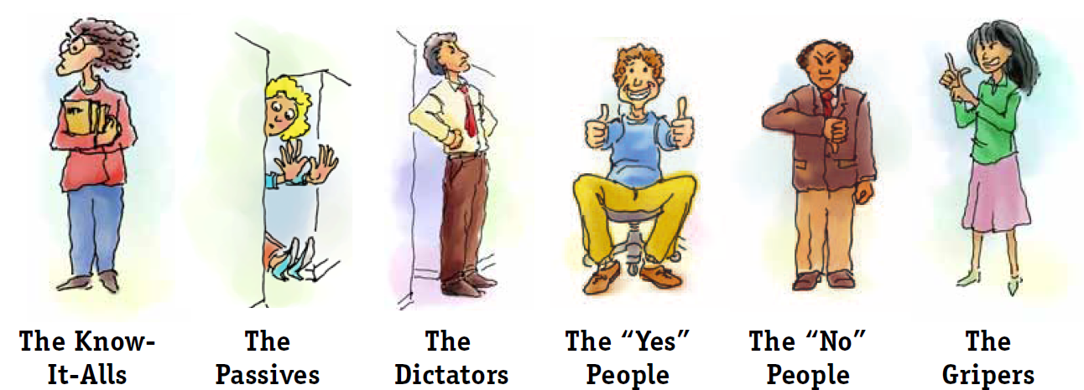
These workers can be found in a variety of workplace settings, including hospitals, nursing care facilities, outpatient clinics (e.g., medical and dental offices, and occupational health clinics), ambulatory care centers, and emergency response settings.
The diversity among HCWs and their workplaces makes occupational exposure to infectious diseases especially challenging.

Slide 4
Direct Contact Transmission
The primary routes of infectious disease transmission in U.S. healthcare settings are contact, droplet, and airborne. Contact transmission can be sub-divided into direct and indirect contact.
Direct contact transmission involves the transfer of infectious agents to a susceptible individual through physical contact with an infected individual (e.g., direct skin-to-skin contact).

Slide 5
Indirect Contact Transmission
Indirect contact transmission occurs when infectious agents are transferred to a susceptible individual when the individual makes physical contact with contaminated items and surfaces (e.g., door knobs, light switches, patient-care instruments or equipment, bed rails, countertops, examination table).
Three examples of contact transmissible infectious agents include Methicillin-resistant Staphylococcus aureus (MRSA) and Vancomycin-resistant enterococcus (VRE) and Coronavirus (Covid 19).

Slide 6
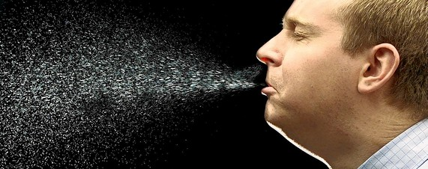
Droplets containing infectious agents are generated when an infected person coughs, sneezes, or talks, or during certain medical procedures, such as suctioning or endotracheal intubation.
Transmission occurs when droplets generated in this way come into direct contact with the mucosal surfaces of the eyes, nose, or mouth of a susceptible individual

Slide 7
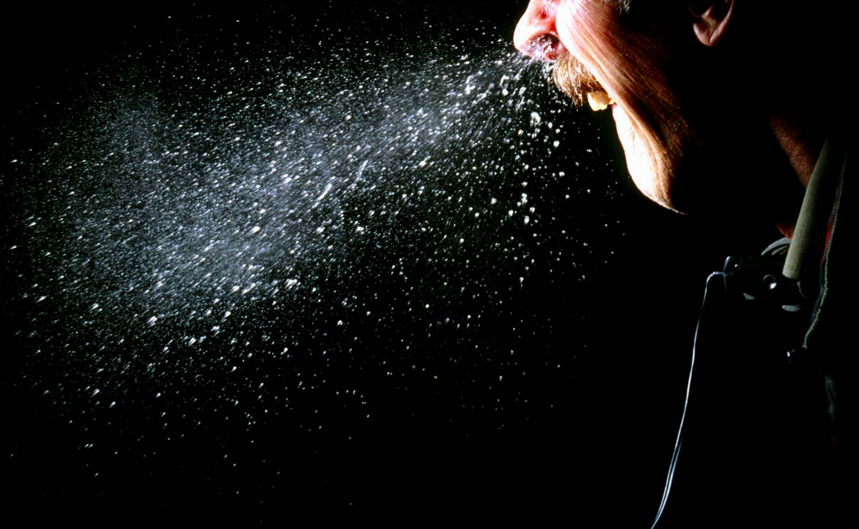
Droplets
Droplets are too large to be airborne for long periods of time, and droplet transmission does not occur through the air over long distances.
Two examples of droplet transmissible infectious agents are the influenza virus which causes the seasonal flu and Bordetella pertussis which causes pertussis (i.e., whooping cough) and Covid 19 which cause the Coronavirus.

Slide 8
Disease Transmission
Airborne transmission occurs through very small particles or droplet nuclei that contain infectious agents and can remain suspended in air for extended periods of time. When they are inhaled by a susceptible individual, they enter the respiratory tract and can cause infection.
Since air currents can disperse these particles or droplet nuclei over long distances, airborne transmission does not require face-to-face contact with an infected individual.
Airborne transmission only occurs with infectious agents that are capable of surviving and retaining infectivity for relatively long periods of time in airborne particles or droplet nuclei.
Only a limited number of diseases are transmissible via the airborne route. Two examples of agents that can be spread through the airborne route include Mycobacterium tuberculosis which causes tuberculosis (TB) and the measles virus (Measles morbillivirus), which causes measles (sometimes called "rubeola," among other names).

Slide 9
Several OSHA standards and directives are directly applicable to protecting workers against transmission of infectious agents. These include
OSHA's Bloodborne Pathogens standard (29 CFR 1910.1030) which provides protection of workers from exposures to blood and body fluids that may contain bloodborne infectious agents;
OSHA's Contact and Airborne standard which provides protection of workers from exposures to Airborne and Contact droplets of body fluids that may contain infectious agents;
OSHA's Personal Protective Equipment standard (29 CFR 1910.132) and Respiratory Protection standard (29 CFR 1910.134) which provide protection for workers when exposed to contact, droplet and airborne transmissible infectious agents; and OSHA's TB compliance directive which protects workers against exposure to TB through enforcement of existing applicable OSHA standards and the General Duty Clause of the OSH Act.

Slide 10
CDC Guidelines
CDC recommendation to assist HCWs in reducing their risks for occupational exposure to infectious diseases.
Personal Protective Equipment (PPE)
Cough and Sneeze Etiquette
Hand Hygiene

Slide 11
What is a pandemic
A pandemic is a global disease outbreak. An influenza pandemic occurs when a new influenza virus emerges for which there is little or no immunity in the human population; it begins to cause serious illness; and then spreads easily person-to-person worldwide.
A worldwide influenza pandemic could have a major effect on the global economy, including travel, trade, tourism, food consumption and eventually, investment and financial markets. Planning for pandemic influenza by business and industry is essential to minimize a pandemic's impact.

Slide 12
It is difficult to predict when the next influenza pandemic will occur or how severe it will be. Wherever and whenever a pandemic starts, everyone around the world is at risk.
Countries might, through measures such as border closures and travel restrictions, delay arrival of the virus, but cannot stop it
During a pandemic, transmission can be anticipated in the workplace, not only from patient to workers in health care settings, but also among co-workers in general work settings.
A pandemic would cause high levels of illness, death, social disruption, and economic loss.

Slide 13
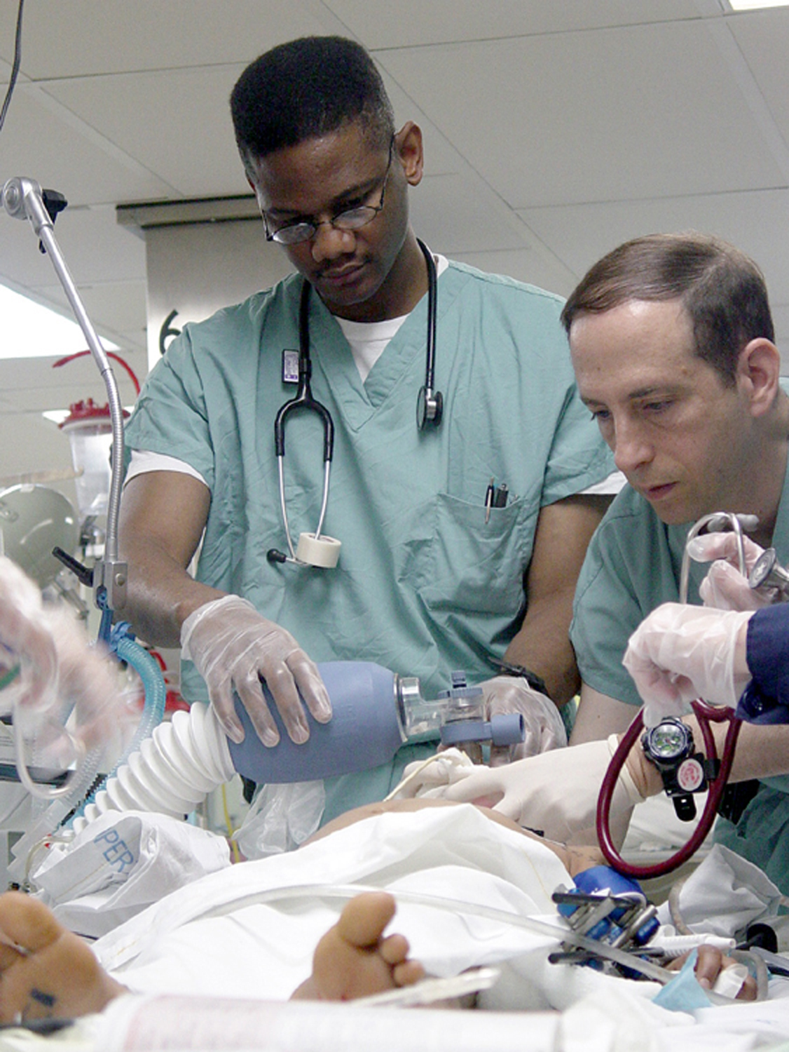
Everyday life would be disrupted because so many people in so many places become seriously ill at the same time.
Impacts could range from school and business closings to the interruption of basic services such as public transportation and food delivery.
Education and outreach are critical to preparing for a pandemic. Understanding what a pandemic is, what needs to be done at all levels to prepare for pandemic influenza, and what could happen during a pandemic helps us make informed decisions both as individuals and as a nation.
Should a pandemic occur the public must be able to depend on its government to provide scientifically sound public health information quickly, openly and dependably.

Slide 14
Novel Coronavirus COVID-19
According to the U.S. Centers for Disease Control and Prevention (CDC), Chinese authorities identified the new coronavirus, which has resulted in confirmed human infections in China and a growing number of other countries, including the United States.
Infected patients have also spread the virus to healthcare workers.

Slide 15
Community spread means people have been infected with the virus in an area, including some who are not sure how or where they became infected.
Different parts of the United States are seeing different levels of COVID-19 activity. U.S. COVID-19 cases include those among travelers, cases among close contacts of a known case, and community spread.
Many types of workers may have similar exposure risks as other members of the general American public.

Slide 16
Exposure risk may be elevated for workers who interact with potentially infected individuals, including those involved in:
Healthcare
Deathcare
Laboratories
Airline operations
Border protection
Solid waste and wastewater management
Travel to areas where the virus is spreading

Slide 17
There is much more to learn about the transmissibility, severity, and other features associated with COVID-19 as the outbreak investigation continues.
Infected people can spread COVID-19 through their respiratory secretions, especially when they cough or sneeze. According to the CDC, spread from person-to-person is most likely among close contacts (about 6 feet).
Person-to-person spread is thought to occur mainly via respiratory droplets produced when an infected person coughs or sneezes, similar to how influenza and other respiratory pathogens spread.
These droplets can land in the mouths or noses of people who are nearby or possibly be inhaled into the lungs.

Slide 18
Quick Facts
Quick Facts

Slide 19
Existing OSHA standards apply to protecting workers from the novel coronavirus, COVID-19.
Signs and symptoms of infection with COVID-19 include fever, cough, and shortness of breath.
Some people who get the COVID-19 may experience only mild illness. However, the virus can also cause pneumonia, which may be severe.
The U.S. Centers for Disease Control and Prevention (CDC) believes at this time that symptoms of COVID-19 may appear in as few as 2 days or as long as 14 days after exposure to the virus.
COVID-19 cases in the United States include cases among travelers, cases among close contacts of a known case, and community-acquired cases where the source of the infection is unknown.
CDC issued a warning notice to avoid all non-essential travel to China. CDC and U.S. Customs and Border Protection have implemented enhanced health screenings to detect travelers with fever, cough, or difficulty breathing when entering the United States.

Slide 20
Modes of transmission of virus causing COVID-19: implications for IPC precaution recommendations

Slide 21
Modes of transmission of the COVID-19 virus
Respiratory infections can be transmitted through droplets of different sizes: when the droplet particles are >5-10 μm in diameter they are referred to as respiratory droplets, and when then are <5μm in diameter, they are referred to as droplet nuclei.¹
According to current evidence, COVID-19 virus is primarily transmitted between people through respiratory droplets and contact routes.²⁻⁷
In an analysis of 75,465 COVID-19 cases in China, airborne transmission was not reported.⁸

Slide 22
Droplet Transmission
Droplet transmission occurs when a person is in in close contact (within 1 m) with someone who has respiratory symptoms (e.g., coughing or sneezing) and is therefore at risk of having his/her mucosae (mouth and nose) or conjunctiva (eyes) exposed to potentially infective respiratory droplets.
Transmission may also occur through fomites in the immediate environment around the infected person.⁸
Therefore, transmission of the COVID-19 virus can occur by direct contact with infected people and indirect contact with surfaces in the immediate environment or with objects used on the infected person (e.g., stethoscope or thermometer).

Slide 23
Airborne Transmission
Airborne transmission is different from droplet transmission as it refers to the presence of microbes within droplet nuclei, which are generally considered to be particles <5μm in diameter, can remain in the air for long periods of time and be transmitted to others over distances greater than
1 m. (3.28feet)

Slide 24
In the context of COVID-19, airborne transmission may be possible in specific circumstances and settings in which procedures or support treatments that generate aerosols are performed; i.e., endotracheal intubation, bronchoscopy, open suctioning, administration of nebulized treatment, manual ventilation before intubation, turning the patient to the prone position, disconnecting the patient from the ventilator, non-invasive positive-pressure ventilation, tracheostomy, and cardiopulmonary resuscitation.

Slide 25
There is some evidence that COVID-19 infection may lead to intestinal infection and be present in feces. However, to date only one study has cultured the COVID-19 virus from a single stool specimen.⁹
There have been no reports of fecal−oral transmission of the COVID-19 virus to date.

Slide 26
Conclusions
At the same time, other countries and organizations, including the US Centers for Diseases Control and Prevention and the European Centre for Disease Prevention and Control, recommend airborne precautions for any situation involving the care of COVID-19 patients, and consider the use of medical masks as an acceptable option in case of shortages of respirators (N95, FFP2 or FFP3).¹⁸⁻¹⁹

Slide 27
Based on the available evidence, including the recent publications mentioned above, WHO continues to recommend droplet and contact precautions for those people caring for COVID-19 patients.
WHO continues to recommend airborne precautions for circumstances and settings in which aerosol generating procedures and support treatment are performed, according to risk assessment.¹³

Slide 28
Current WHO recommendations emphasize the importance of rational and appropriate use of all PPE,²⁰ not only masks, which requires correct and rigorous behavior from health care workers, particularly in doffing procedures and hand hygiene practices.²¹
WHO also recommends staff training on these recommendations,²² as well as the adequate procurement and availability of the necessary PPE and other supplies and facilities.
Finally, WHO continues to emphasize the utmost importance of frequent hand hygiene, respiratory etiquette, and environmental cleaning and disinfection, as well as the importance of maintaining physical distances and avoidance of close, unprotected contact with people with fever or respiratory symptoms.

Slide 29
Thank you
Jackson-hinds comprehensive health center production
Sandra Gray, Safety/Compliance Officer

